Slide 1
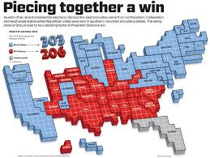
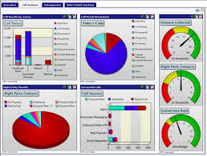
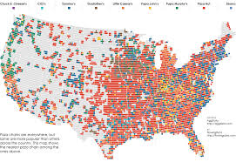
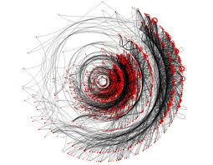
Data Visualization, Presentation, and Storytelling

Slide 2
Data and Information Visualization Concepts and Current Trends

Slide 3
Data and Information Visualization
Information visualization focuses on presenting relationships that are already known (e.g., dashboards)
Data visualization focuses on finding new relationships (e.g., discovery analytics)

Slide 4
Purpose of Visualization
Exploration / Explorative Analysis
Open-end undirected search
gain insight into the data, formulate hypotheses
begin extracting relevant information
Confirmation / Confirmative Analysis
directed search
verify or reject hypotheses
Presentation
communicate and disseminate analysis results
interactivity

Slide 5
Data Visualization
The combination of big data, very large data sets, and many variables have fostered the use of new visualization techniques
The need is to look at many variables at the same time

Slide 6
Data visualization has a long history
Mystery: What was causing the cholera epidemic in London in 1854?

Slide 7
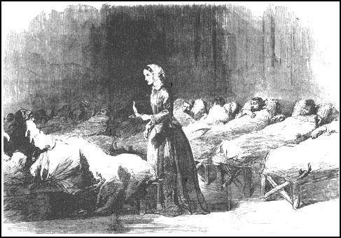
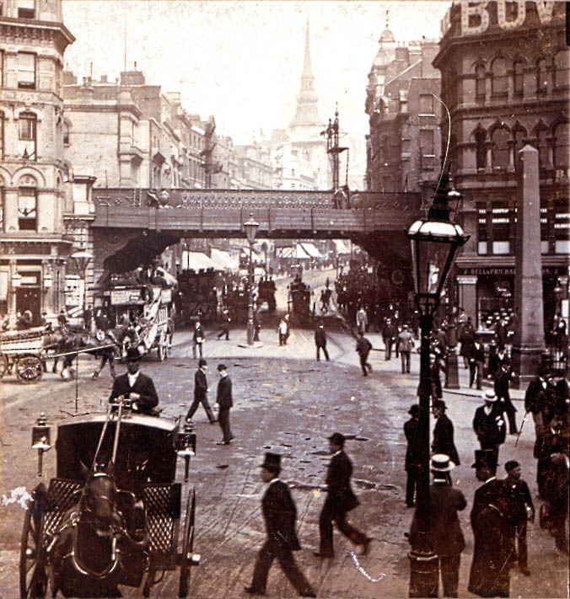
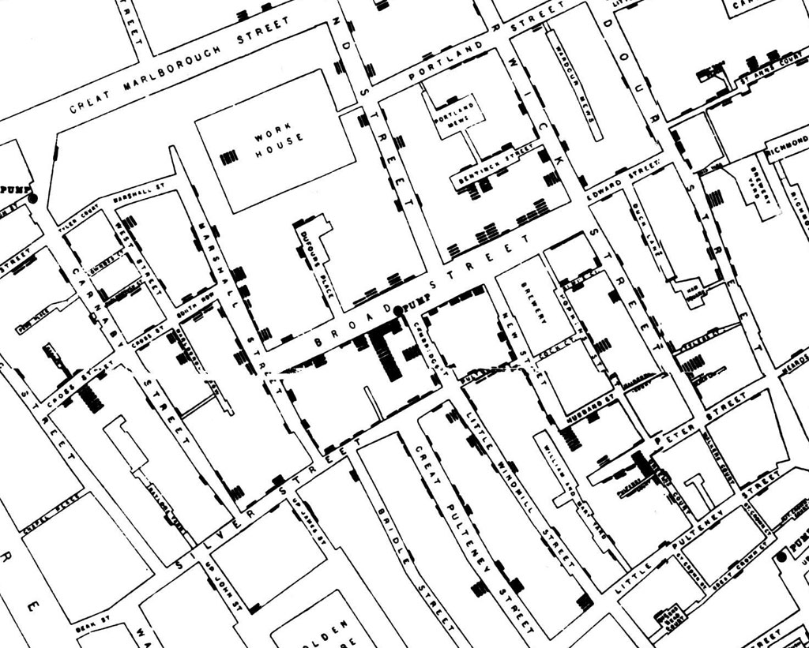
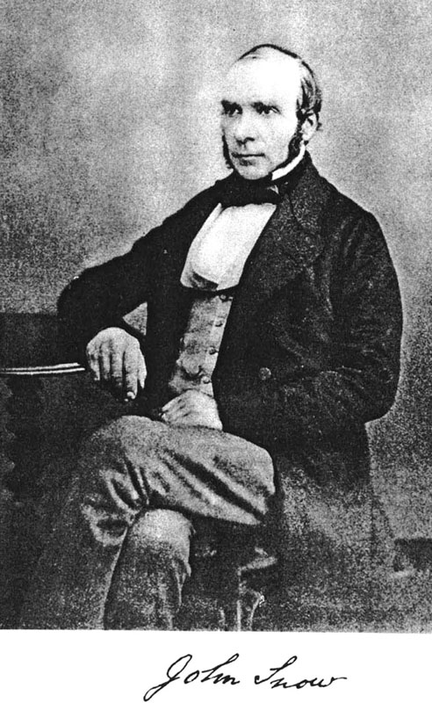
London 1854
Notes:
London 1854. A deadly cholera epidemic broke out and killed 93 people only within the first week of September. Physicians and municipality are helpless and do not know how the disease is transmitted at that time. Nobody knows how to get grip on this situation. Many people believe in so-called “miasms” transmitted through air. But Dr. John Snow has his own theory and supposes that cholera might be transmitted via contaminated water. Because of this, he walks from door to door in Soho, gathers data, and plots the locations of all deaths on map of central London. Additionally, he marks all places where water pumps are located. He analyzes the graphed data and spots a clear pattern: most deaths occurred near the water pump in Broad Street. He interprets his analysis and reasons that contaminated water from this pump must be the cause for the epidemic. Based on this graphic evidence, he convinces the municipality to remove the handle of this pump and within days the cholera epidemic has ended.

Slide 8
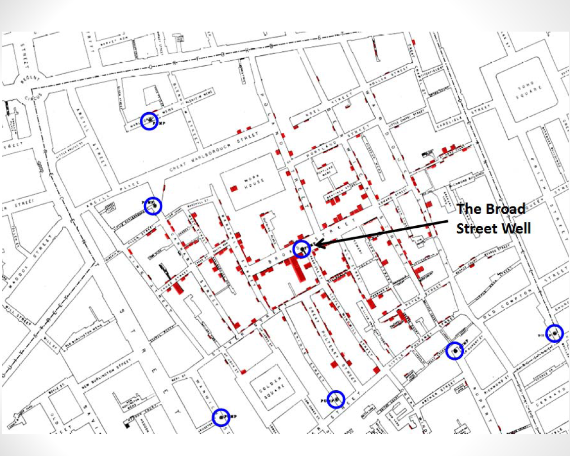

Slide 9
Data: Before Visualization
I
X Y
II
X Y
III
X Y
IV
X Y
What relationships exist between X and Y in the four datasets?
10.0
8.0
13.0
9.0
11.0
14.0
6.0
4.0
12.0
7.0
5.0
8.04
6.95
7.58
8.81
8.33
9.96
7.24
7.26
10.84
4.82
5.68
10.0
8.0
13.0
9.0
11.0
14.0
6.0
4.0
12.0
7.0
5.0
9.14
8.14
8.74
8.77
9.26
8.10
6.13
3.10
9.13
7.26
4.74
7.46
6.77
12.74
7.11
7.81
8.84
6.08
5.39
8.15
6.42
5.73
10.0
8.0
13.0
9.0
11.0
14.0
6.0
4.0
12.0
7.0
5.0
8.0
8.0
8.0
8.0
8.0
8.0
8.0
19.0
8.0
8.0
8.0
6.58
5.76
7.71
8.84
8.47
7.04
5.25
12.50
5.56
7.91
6.89
Notes:
68

Slide 10
Data: After Visualization
I
II
10
10
5
5
10
20
10
20
III
IV
10
10
5
5
10
20
10
20
F.J. Anscombe, “Graphs in Statistical Analysis,” American Statistician, 37 (February 1973), 17-21.
Notes:
69

Slide 11
Humans can distinguish differences in line length, shape
orientation, size, placement on page, and color with
minimum cognitive processing effort.

Slide 12
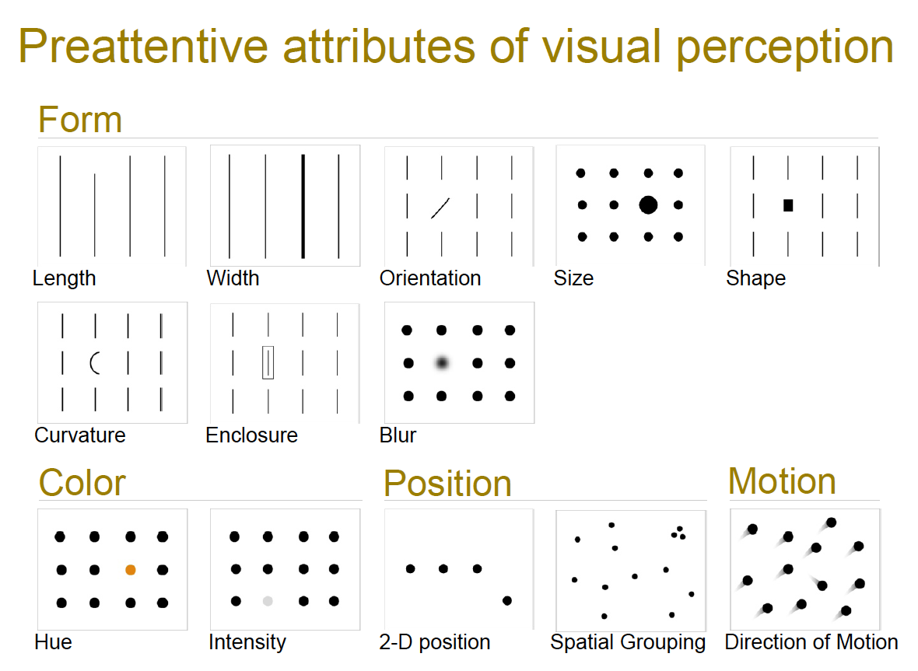

Slide 13
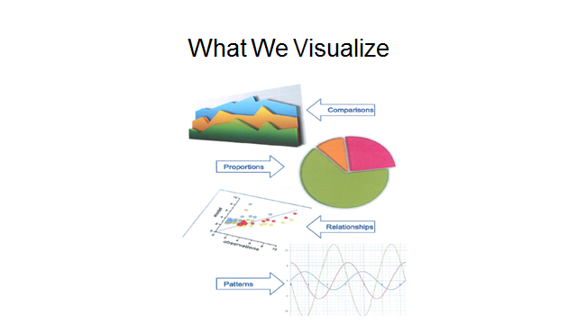

Slide 14
Traditional, familiar visualizations
Reports (yes, a report is a visualization)
Bar charts
Line charts
Pie charts

Slide 15
Sparklines Consist of
A single line that shows a performance metric over time
The current value
There is no scale

Slide 16
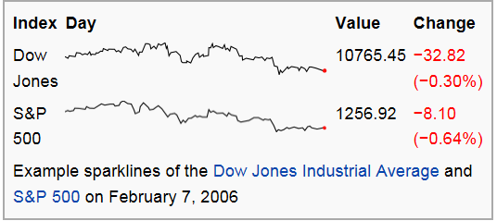
Somewhat familiar visualizations
Sparkline

Slide 17
Performance Bars Consist of
A text label to identify the measure
A bar to encode the value of the measure
One or more perpendicular short lines to encode comparative measures
A quantitative scale to place measures in the context of the range of potential values
Background fill measures to assign qualitative ranges to the quantitative scale to communicate an immediate evaluation of the measure

Slide 18
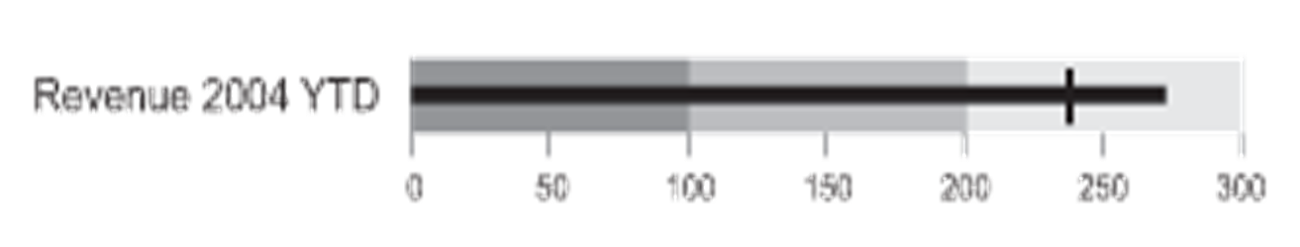
Somewhat familiar visualizations
A Performance bar
(Also called Bullet charts)

Slide 19
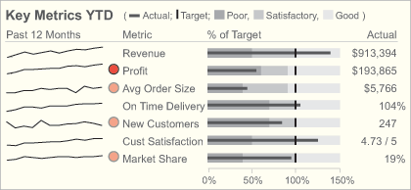
A Sparkline and Performance Bar

Slide 20
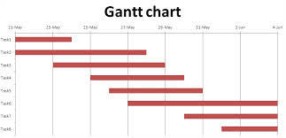
Somewhat familiar visualizations
Shows the component parts of a project
Most often shows when the component parts start and stop
Gantt charts

Slide 21
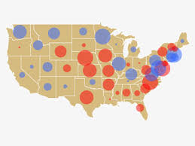
Somewhat familiar visualizations
A technique to accentuate data on scatter plots or maps
The size of the bubbles provide meaning about the data
Bubble charts

Slide 22
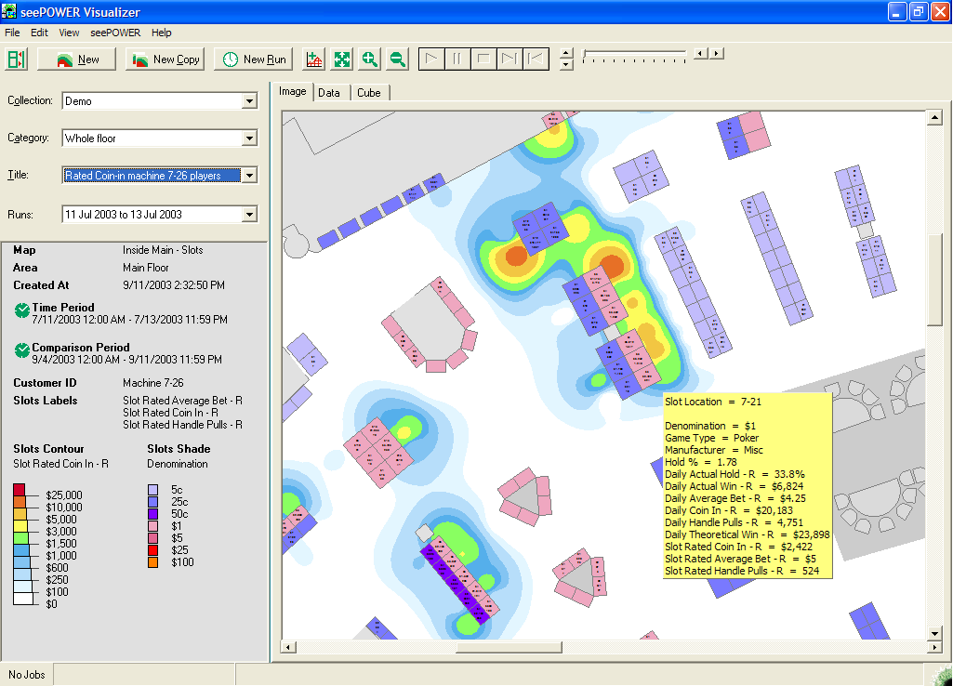
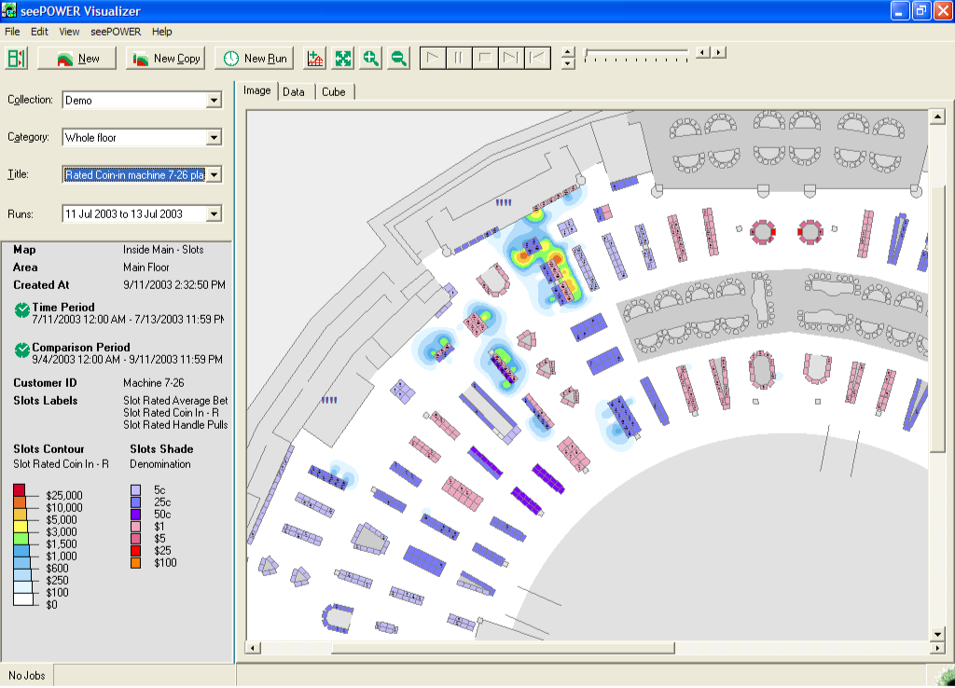
Somewhat familiar visualizations
Zoom In
Heat Map

Slide 23
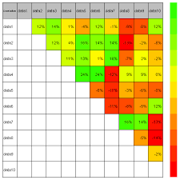
Somewhat familiar visualization
Take heat maps one step further
Numbers are added on top to provide additional detail
Highlight table

Slide 24
Power of Animations
Quickly see changes through time
Quickly see large numbers of metrics
See comparisons
See several levels of detail
Eye is powerful at movement detection

Slide 25
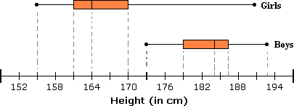
Less familiar visualizations
The line end points show the minimum and maximum values
The boxes identify quartiles
The median value is also marked
Box-and-whisker plot

Slide 26
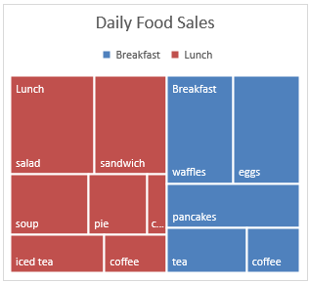
Less familiar visualizations
Rectangles are nested within other rectangles to show hierarchical data as a proportion to the whole
Each rectangle can be thought of as a branch of a tree and each rectangle within a rectangle is a sub-branch
The size of the rectangle is proportional to how much data it represents
Tree maps

Slide 27
What Are Infographics
Infographics are graphic visual representations of information, data, or knowledge intended to present information quickly and clearly
They can be considered art projects
They add visual “punch” to a story, website, or presentation

Slide 28
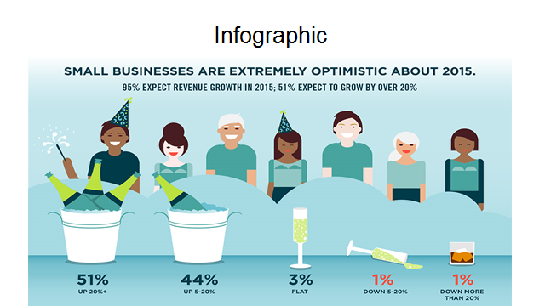


Slide 29
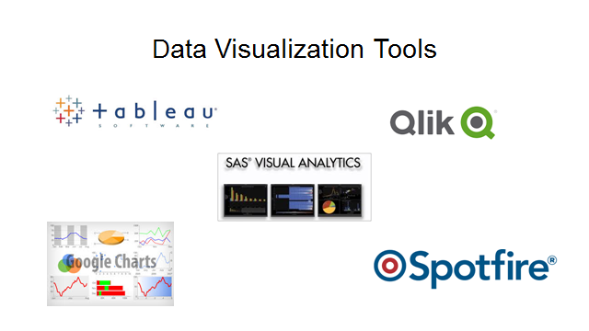
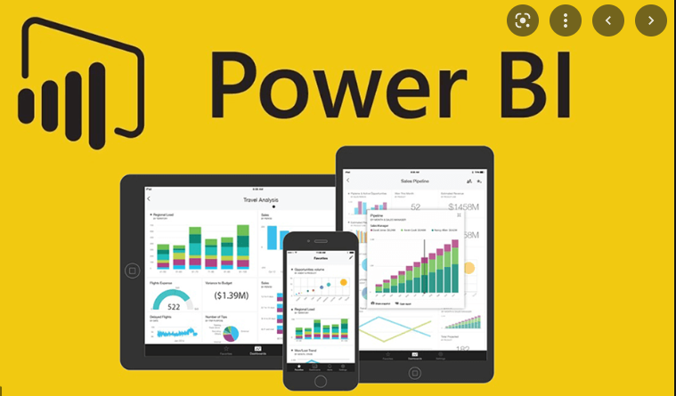

Slide 30


We can, but should we …
Two Stories
The retinal scan
The MTV screen designers

Slide 31
What Research Tells Us
The accuracy of interpretation of tabular data is surprisingly low
Simple, familiar charts (e.g., bar, line, pie) are more accurately interpreted than advanced, less familiar ones (e.g., stacked bar, and bubble)
Simple, familiar charts (e.g., pie, column, line, and bar) are interpreted most quickly
User confidence is highly correlated with how frequently charts are encountered; the more people use a particular kind of visualization, the more confident they are with it.
However, user confidence does not always correlate with the accuracy of interpretation. Just because someone is confident with a visualization does guarantee that the data will be interpreted correctly.

Slide 32

The Data Interpreter
Users are likely to have problems interpreting advanced, unfamiliar visualizations
This requires the data interpreter role
This person explains visualizations to executives, LOB managers, and other users who need help in interpreting visualizations

Slide 33
The Data Interpreter
This role may be fulfilled by someone whose job is to do this or by administrative assistants, BI or business analysts, or data scientists
The data interpreter must understand
the audience
the business domain
the problem
the problem the visualization addresses
the visualization
how to tell a story
how to communicate well

Slide 34

Presentations Using Storytelling Concepts

Slide 35

Traditional Presentations
Traditional presentations are often boring and ineffectual: “Death by PowerPoint”
Too much data, fail to communicate a clear message, are incomprehensible, and don’t lead to action

Slide 36
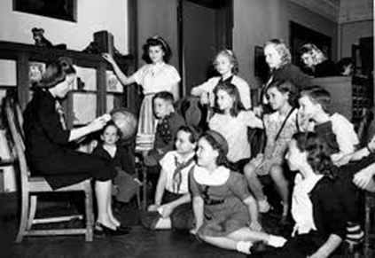
Storytelling
Captures the listeners’ attention with a narrative supported by visualizations
Help people get the gist of an idea quickly
People remember facts much better when wrapped in a story
Stories are memorable
All stories are different

Slide 37
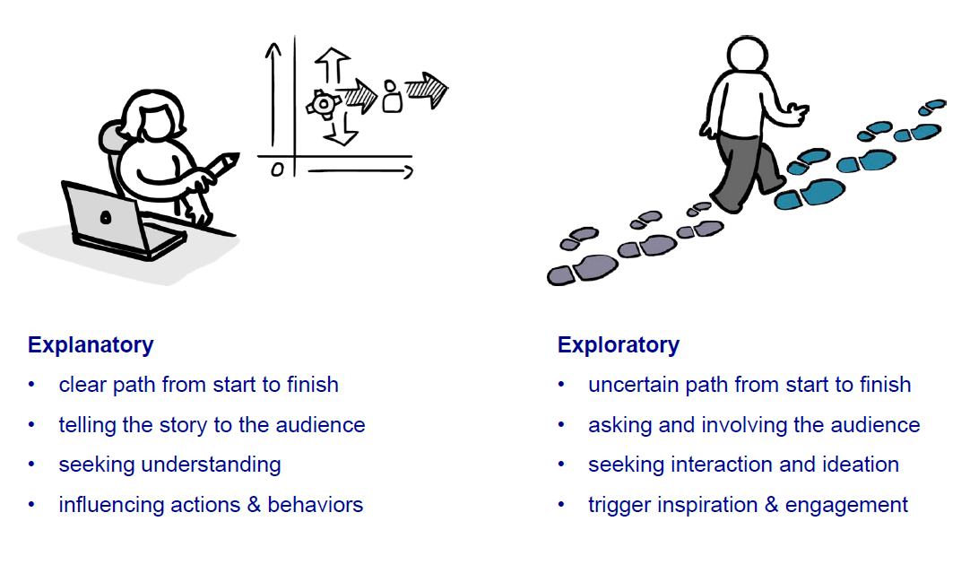
Explanatory versus Exploratory Stories
Notes:
Storytelling can be used in many different settings with a variety of audiences, including a self-running presentation; a live presentation to a large audience; or a live presentation to an
individual or small group, which allows interaction with the listener or listeners. Stories can be used to explain or to help the audience explore a topic. Each of these scenarios affects the
techniques used, the way the presentation is structured, and the amount of interaction anticipated.

Slide 38
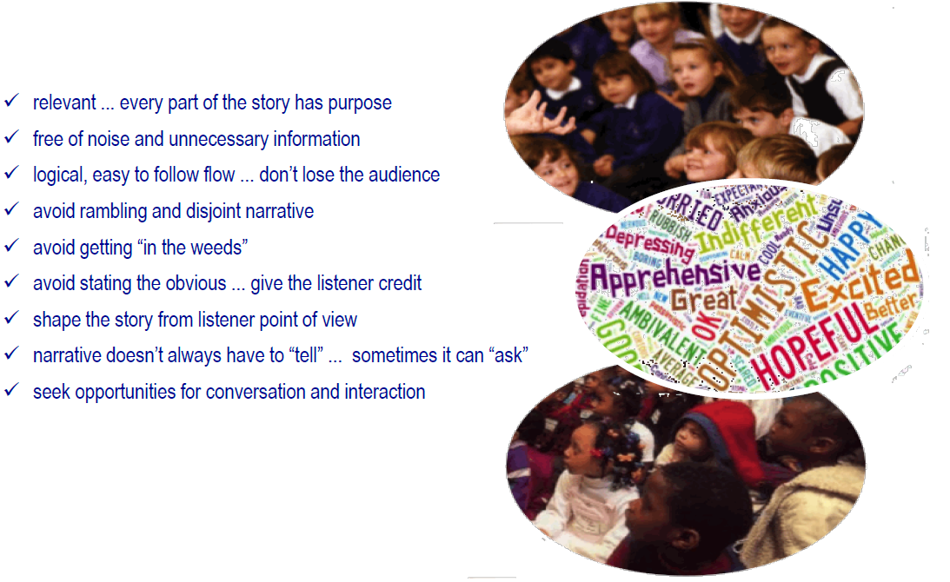
Storytelling Tips
Notes:
Follow these story telling tips and make better presentations.

Slide 39

Focus on the Story
Stories have a beginning, middle, and end
Describe the current situation, provide an analysis, lay out the options, make a recommendation, describe the likely outcomes
Include specific examples

Slide 40
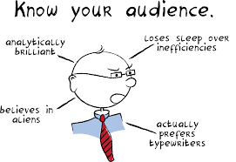
Know Your Audience
Know your audience before putting together your presentation
Who is the most important person in the room?
Personalize it with examples they will remember
Make them understand the importance and value of what you are presenting
Notes:
Your listeners will ask themselves what the story means to them. Put yourself in their place when creating the story. Include specific, personalized examples that
people will remember. For example, politicians often name and describe an individual to illustrate a point, such as someone who is benefiting from Obamacare.

Slide 41



Business and Technical Audiences Are Different

Slide 42
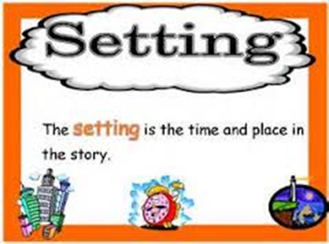
Establish the Setting
Describe the setting in a way that is relevant to the listener
Identify the business issues and challenges
Support the description with data and let listeners know its source, accuracy, and relevance
Try to take a unique and interesting perspective

Slide 43

Define the Characters
Identify who is being affected – company’s bottom line, customers, management, or employees
This is where a personal experience can be effectively used

Slide 44
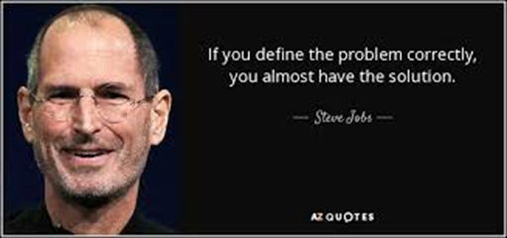
Define the Problem/Conflict
Be strategic and keep the presentation simple, uncluttered, and tasteful
Highlight the critical parts
The more interesting the visualization, the more time and attention the audience will give it

Slide 45

Show the Resolution and Future
Use visualizations to make predictions, layout alternatives, identify a recommended course of action, and show likely outcomes
Notes:
Presentations should do more than identify a problem. They should suggest a resolution or at least lead to a discussion. Use data to make predictions, lay out
alternatives, identify a solution, create a call to action, and show likely outcomes. However, do all of this in a visual, artistic, and thoughtful way.

Slide 46
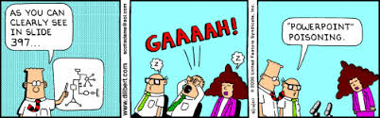
Avoid Death by PowerPoint

